Slide 1

Apache POI
Dima Ionut Daniel

Slide 2
Contents
What is Apache POI?
Apache POI features
Apache POI-HSSF/XSSF
Apache POI-HWPF/XWPF
Apache POI-HSLF/XLSF
Apache POI-HSMF
Apache POI-HDGF
Apache POI-HMEF
Apache POI-FS
Conclusions
Bibliography

Slide 3

What is Apache POI?
Apache POI is an open source project from ASF.
It provides pure Java libraries for reading and writing files in Microsoft Office formats, such as Word, PowerPoint and Excel.

Slide 4
Apache POI features
Apache POI contains following subcomponents:
POIFS – component reads/writes Microsoft OLE 2 Compound document format.
HSSF – reads/writes Microsoft Excel (XLS) format files.
XSSF(XML SpreadSheet Format) – read and writes Office Open XML (XLSX) format files.
HPSF –reads “Dcoument Summary” information from Microsoft Office files.
HWPF – aims to read and write Microsoft Work 97 format files.
HSLF – a pure java implementation for Microsoft PowerPoint files.
HDGF – an initial pure Java implementation for Microsoft Visio binary files.
HPBF – pure implementation for Microosft Publisher files.
HSMF – pure Java implementation for Microsoft Outlook MSG files.
DDF – a package for decoding the Microsoft Office Drawing format.

Slide 5
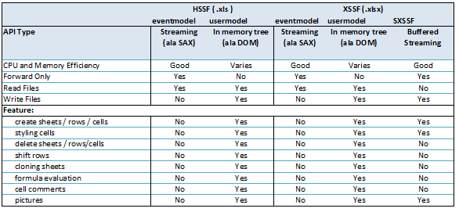
Apache POI-HSSF/XSSF
HSSF is the component for managing Excel ‘97-2007 file formats.
XSSF is the component for managing Excel 2007 OOXML (.xlsx) file formats.
HSSF and XSSF provides methods for crearing, modifying, reading and writing XLS spreadsheets.
SXSSF is an API-compatible streaming extenstion of XSSF to be used when very large spreadsheets have to be produced and heap space is limited.

Slide 6
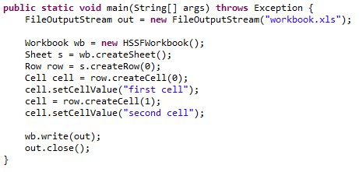
Apache POI-HSSF/XSSF (cont.)
Workbook are created by using the org.apache.poi.ss.usermodel.Workbook class.
Excel sheets are created by calling createSheet() from existing instance of Workbook.
Rows are created by calling createRow() from an existing instance of Sheet.
Cells are created by calling createRow() from an existing instance of Row class.

Slide 7
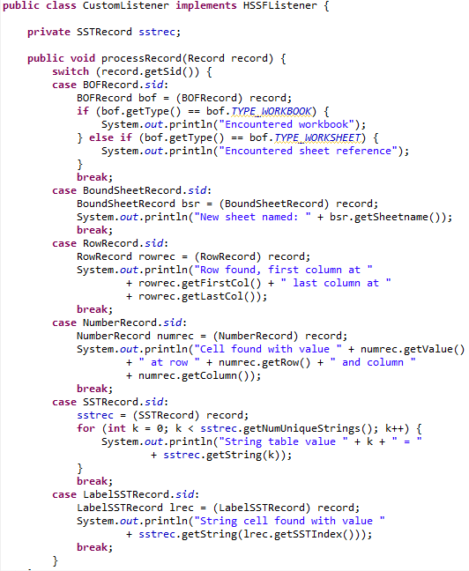
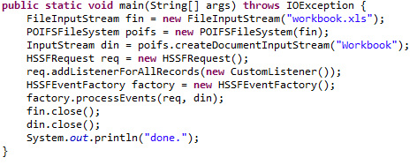
Apache POI-HSSF/XSSF (cont.)
The Event API is newer than the User API.
It is used for Excel document parsing.
The advantage is that we can read an XLS with relatively small
memory footprint.

Slide 8
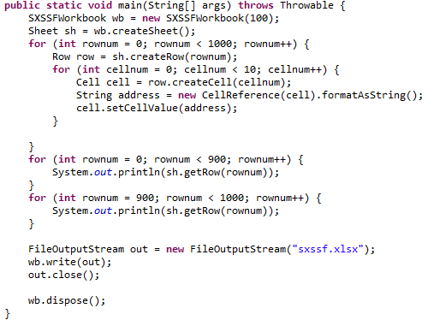
Apache POI-HSSF/XSSF (cont.)
SXSSF is an API-compatible streaming extension of XSSF to be used when large spreasheets needs to be created and heap space is limited.
SXSSF achieved its low memory footprint by limiting access to the rows that are within a sliding window.

Slide 9
Apache POI-HWPF/XWPF
HWPF is the name of the Microsoft Work 97(-2007) file format.
The mai entry point to HWPF is HWPFDocument. Currently is has a lot of references both to internal interfaces and public API package.
The main entry point to XWPF is XWPFDocument. This can be used to get paragraphs, pictures, tables, sections, headers.
A .doc Word document is handled by HWPF can be considered as very long single text buffer.
The HWPF API provides “pointers” to document parts, sections, etc.

Slide 10
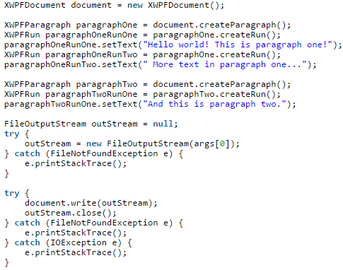
Apache POI-HWPF/XWPF (cont.)
In order to create Word document the XWPFDocument can be used.
Most used objects are XWPFParagraph, XWPFRun, WXPFTable, etc.

Slide 11
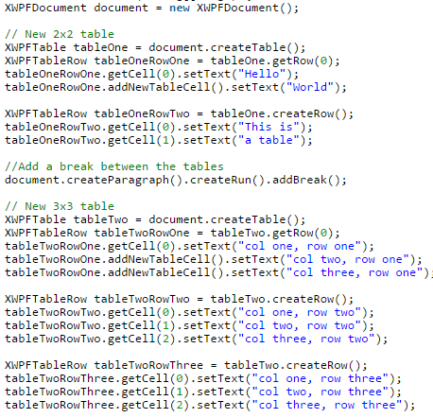
Apache POI-HWPF/XWPF (cont.)
In order to create tables in word document objects like XWPFTable, XWPFTableRow are used.

Slide 12
Apache POI-HSLF/XLSF
HSLF is the POI implementation of the Powerpoint ‘97(-2007) file format.
HSLD provides a way to read, create and modify PowerPoint presentations.
It provides:
Api for fata extraction(text, pictures, embedded objects, sounds)
Usermodel API for creating, reading and modifying ppt files
PowerPointExtractor accepts a file or an input stream and is used for basic text extraction.
PowerPoint documents are made up of a tree of records.

Slide 13
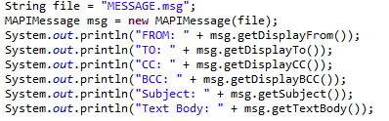
Apache POI-HSMF
HSMF represents the POI API implementation for the Outlook MSG format.
It provides low-level read access to all of the file, along with ta user-facing way to get at the common textual contet of MSG files.
MAPIMessage can be used to parse Outlook message body parts.
Also attachements from Outlook MSG format can be retrieved using the getAttachementFile().
Headers can be retrieved using getHeaders() method.

Slide 14
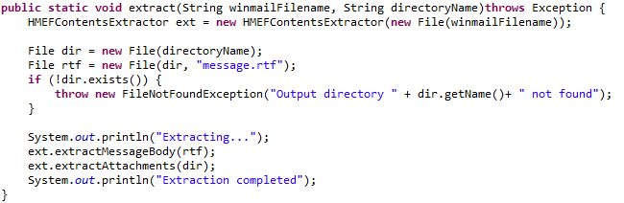
Apache POI-HMEF
HMEF is a API POI implementation for Microsoft TNEF(Transport Neutral Encoding Format), aka winmail.dat, which is used by Outlook and Exchange in some situations.
HMEF provides a read-only API for accessing common message and attachment attributes, including the message body and attachment files.
In addition, it’s possible to have read-only access to all of the underlying TNEF and MAPI attributes of the message and attachments.
HMEF provides a command line tool for extracting out the message body and attachment files from a TNEF file.

Slide 15
Apache POI-HDGF
HDGF represents the POI API implementation for Visio file format.
The API provides a low-level, read-only api for accessing Visio documents.
It provides a way to extract the textual content from a file.
HDGF comes with the VSDDumper to print out the contents of a visio file.

Slide 16
Apache POIFS
Apache POI-FS is a java implementation for OLE2 Compound document format.
The operations that can be done are: read, write, modify data strucuture to organize their content.

Slide 17
Conclusions
Apache POI is a documented, Java based, easy to use API for creating Microsoft Documents.
Contains Office Open XML support

Slide 18

Bibliography
http://poi.apache.org/
http://en.wikipedia.org/wiki/Apache_POI
http://stackoverflow.com/questions/13507424/how-to-create-a-word-document-using-apache-poi

